Slide 1
NEWYORK CITY TAXI DATA

Slide 2
DATA DESCRIPTION
One Month Data (April 1st,2013 to April 31st, 2013)
13,401 Taxis
33091 Drivers
42 Million Miles
$221 Million Revenue
Trips with 0 seconds 8521
Trips with 0 miles are 67594
Most of the payments are done with credit card and cash.
There are five types of rate codes (Standard city rate, JFK Airport rate, LA GAURDIA Airport rate ,WESTECHESTER country rates, out of city rates)

Slide 3
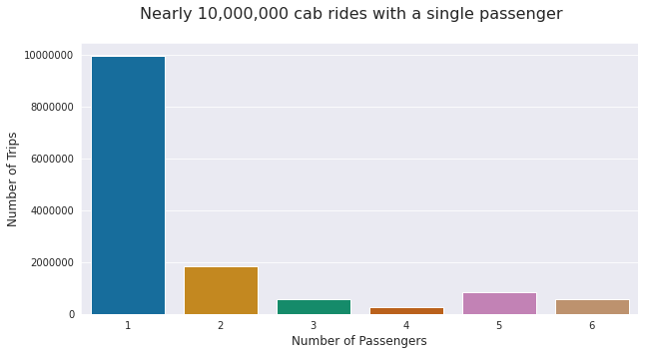
What is the distribution of number of passengers per trip?
I have removed the trips with more than 6 passengers according to NYC taxi rules which allows only 4 to 6 members (including children) depends on taxi type.

Slide 4
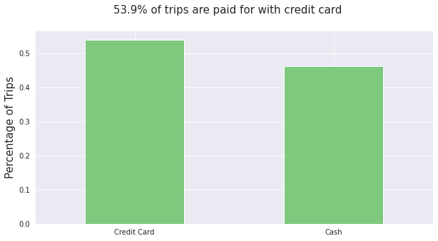
What is the distribution of payment type?
I have removed the other categories of payment types as they are very less in number compared to these two. The other categories are NOC,DIS,UNK.

Slide 5
Types of Fares and Tips
I have divided the whole data into Airport data and Non-airport data based on the rate codes.
We can easily say from the data that Airport amounts are bit high compared to non-airport amounts.

Slide 6
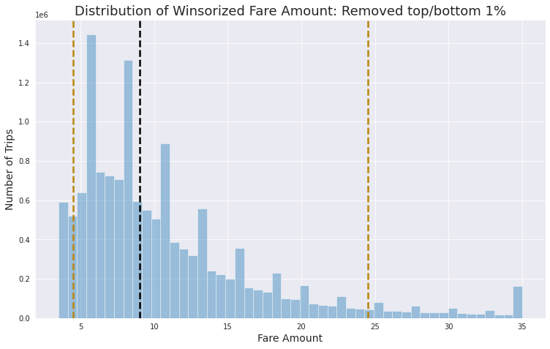
What is the distribution of fare amount?
Winsorization is the process of replacing the extreme values of statistical data in order to limit the effect of the outliers on the calculations or the results obtained by using that data.

Slide 7
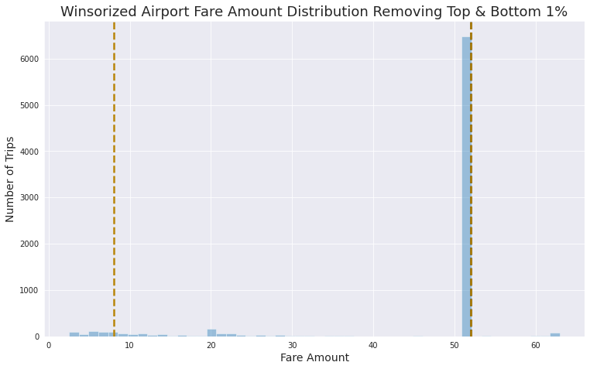
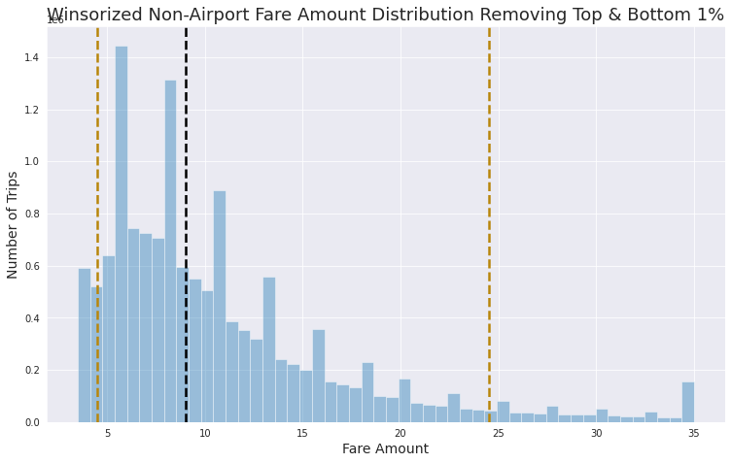
Airport Fare vs Non-Airport Fare
Most common airport fare is 52(Mode and Median) and in case of non-airport fares median is 9,lower value (Q1) IS 4.5, and the Upper value (Q3) is 24.5.

Slide 8
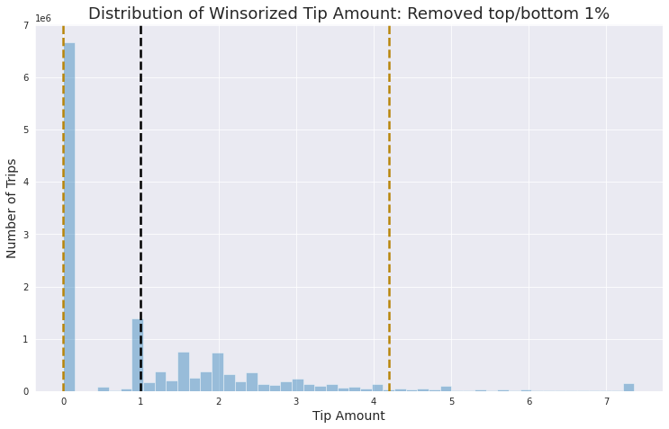
What is the distribution of tip amount?
Median:1, Q1=0, Q3=4.2.

Slide 9
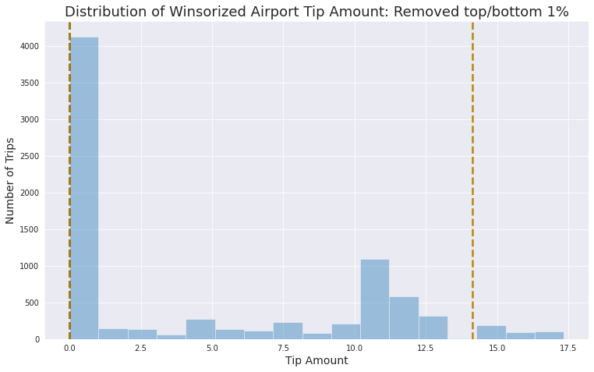
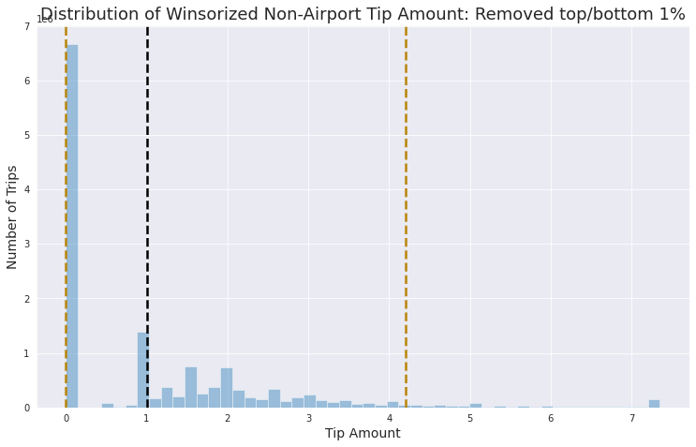
Airport Tips vs Non-Airport Tips
Median and Q1 are same (0) for Airport Tips and Q3 is 14.3 but in case of Non-airport median is 1, Q1 is 0 and Q3 is 4.2. Non-Airport Tips distribution is almost similar to overall distribution.

Slide 10
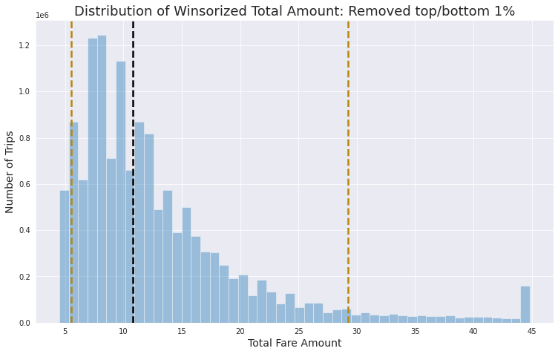
What is the distribution of total amount?
Median is 10.8, Q1 is 5.5 and Q3 is 29.25.

Slide 11
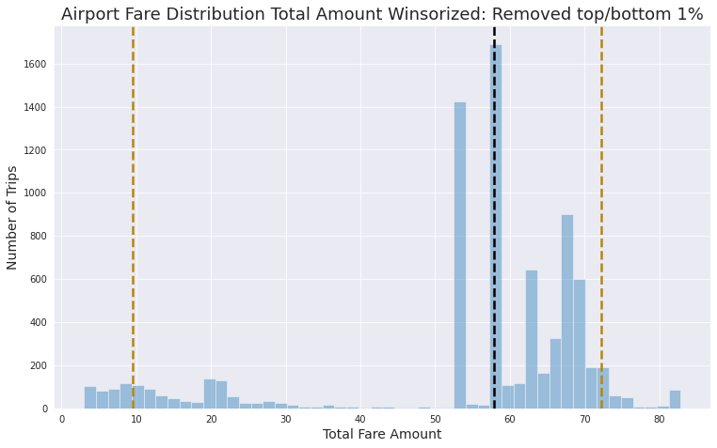
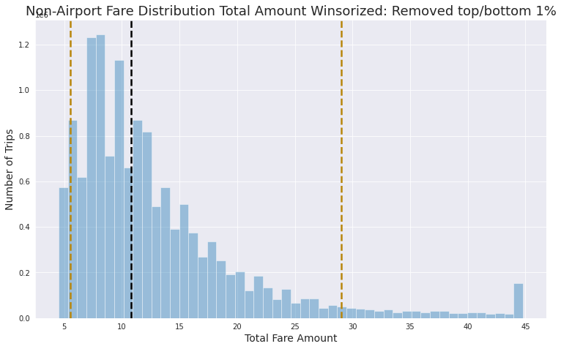
Airport Total amount vs Non-Airport Total amount
Airport total amount median value is also very high which is 57.83 compared to 10.8 in case of Non-airport total amount and it is greater than Q3 (29.25) of Non-Airport also.

Slide 12
What are the Top 5 busiest hours of the day?
I solved this problem using two methods:
Trip counts:
In this method, I created a data frame with date column of April month and other columns with all hour values (0 to 24) with number of trips as values in the data frame then I plotted box plot for all columns.
Passenger counts:
In this method, I did group by hour column and aggregate the passenger count values and ordered the data frame to descending order to find the top 5 rows which is busiest locations in our case. I created two other columns such as week day name and hour then created a pivot table based on passenger count as values, hour as index and day of week as columns. After creating a pivot table, I plotted the heat map of the pivot table.

Slide 13
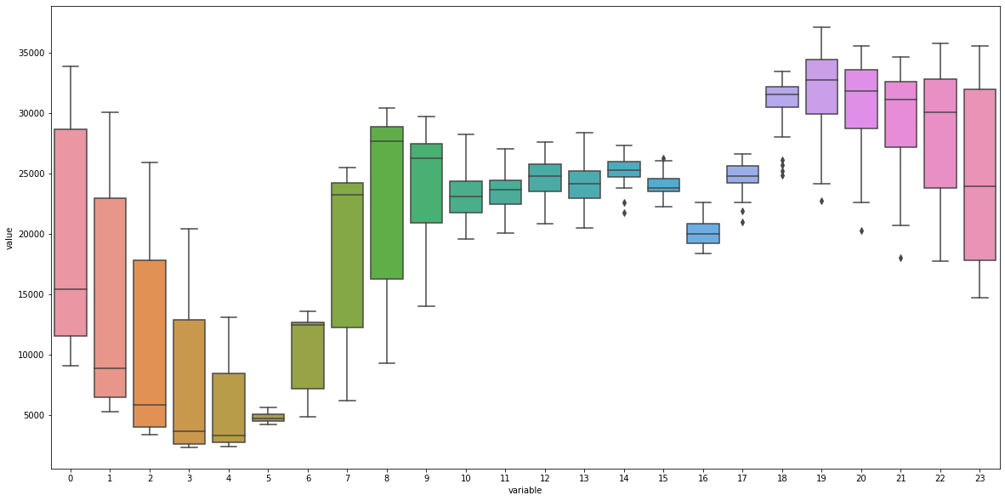
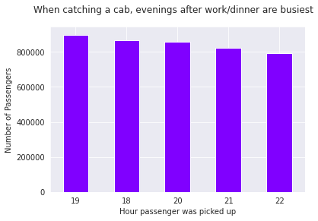
Trips count vs Passengers count
We can clearly say that the evening hours 6pm to 10pm are the top 5 busiest hours of the day.

Slide 14
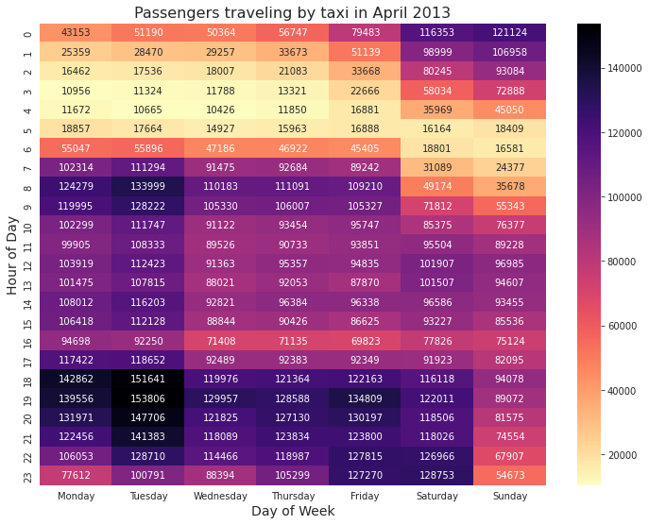
Passengers count heat map

Slide 15
What are the Top 10 busiest locations of the city?
There are two types of locations are there such as pickup (latitude and longitude) and drop-off (latitude and longitude).I used geopy library which had Nominatim function which gives address from the latitude, longitude values and vice-versa.
I have observed that the pick up and drop off geocodes i.e., latitude and longitude values of top 10 locations are same.
There are 64 lakh trips for pickup and 59 lakh trips for drop off for top 10 locations.

Slide 16
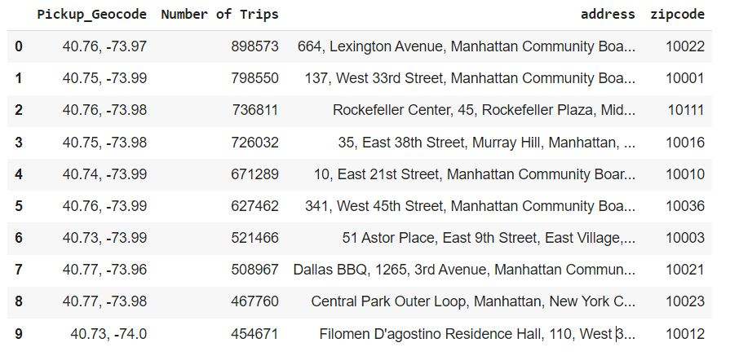
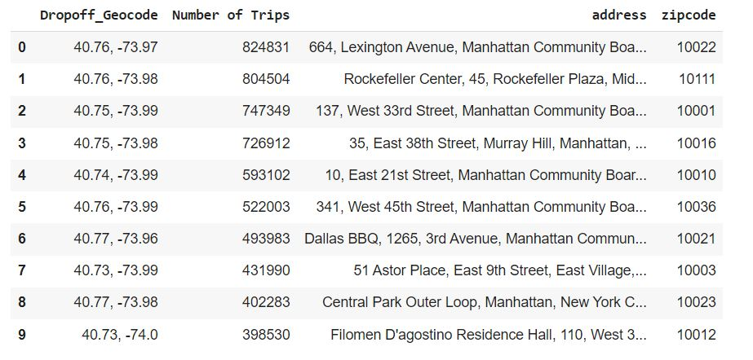
Pickup and Drop-off data frames

Slide 17
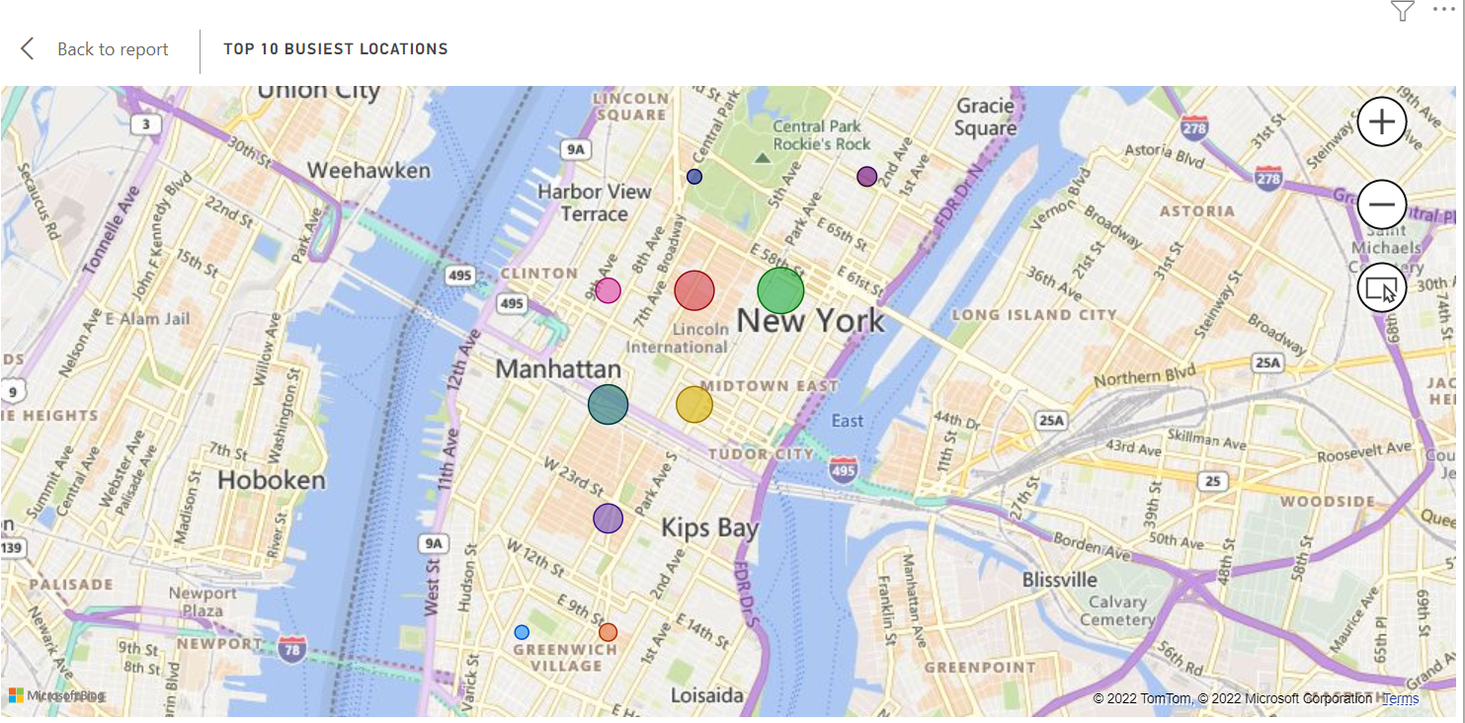
Top 10 busiest locations Map
We can say that the all locations are in Manhattan and there are total 12.36 million trips in Manhattan.

Slide 18
Which trip has the highest standard deviation of travel time?
Each trip is uniquely defined by its pickup and drop off co-ordinates. It is important to determine what minimum sample size of trips to use to calculate the standard deviation.
If there is a unique trip for example, then we cannot calculate it’s standard deviation of travel times.
What minimum sample size do we need to determine the standard deviation of trip times? If there is a trip that has occurred twice, one trip being 5 minutes long and one trip being an hour long, this trip will have a very high standard deviation based on a relatively small sample.
Assumptions: MOE = 5%,CI = 95% (Z-score=1.96),std = 0.5 (assuming 50% gives large sample size)
Sample Size = ((1.96 x 0.5)/0.05)^2 = 384.16
= 385 trips

Slide 19
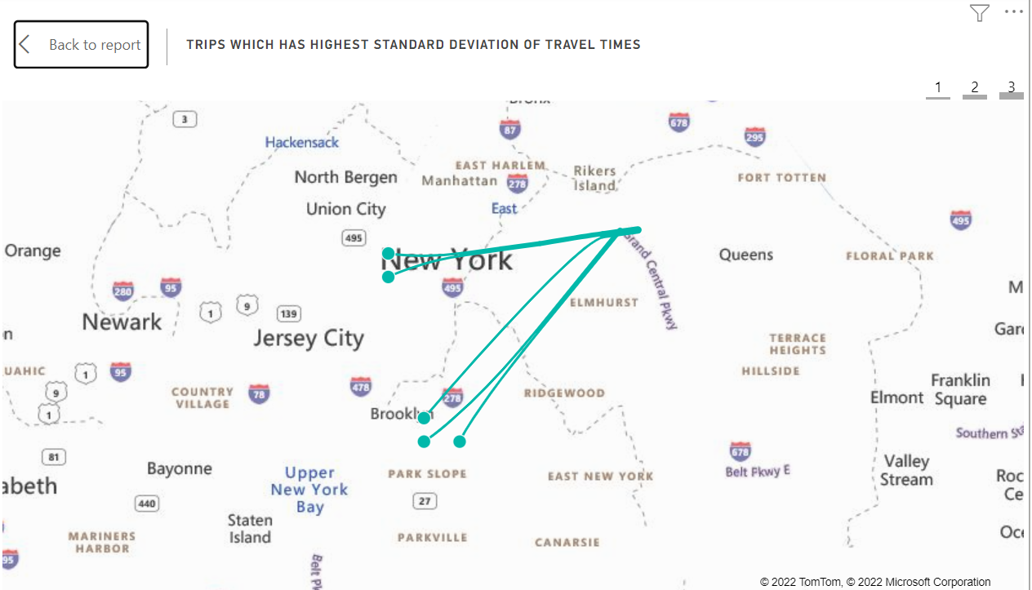
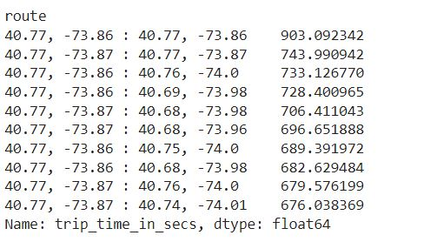
Trips with highest standard deviation of travel times
I considered the routes with more than 385 trips (sample) to determine standard deviation.
These are the routes with highest standard deviation of travel times.

Slide 20
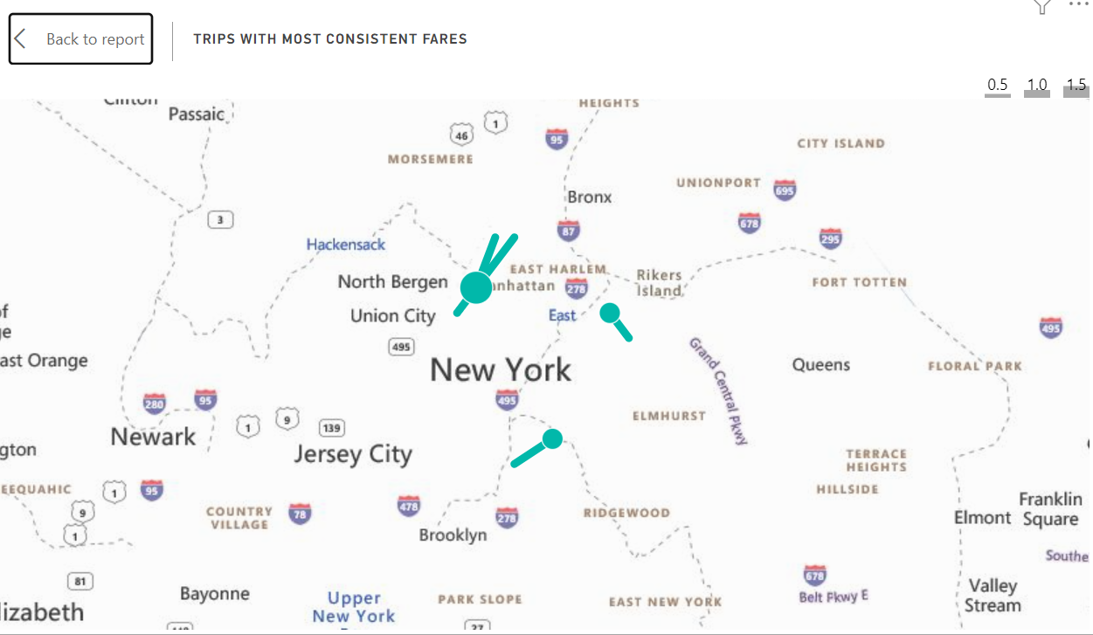
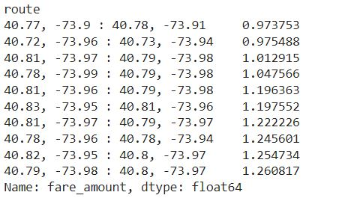
Which trip has most consistent fares?
The trips which has most consistent fares which means fares with less standard deviation of fare amount. These are the routes in which trips has most consistent fares.

Slide 21
In What trips can you confidently use respective means as measure of central tendency to estimate fare, time taken, etc.
As discussed in question 8 , certain trips may only occur once or twice, making calculations of central tendency based on these trips biased and erroneous. If the same trip takes twice as long for one taxi driver as it does for another, and our population is two trips, this skews calculated means and variances.
So how many occurrences of the same trip are required before measures of central tendency can be calculated with confidence?
I make some assumptions and got the required sample size is 385 trips, which is the minimum threshold of trip occurrence over the month to be comfortable calculating measures of central tendency to estimate fares.
Most of the trips which originate and end in Manhattan, including trips to La Guardia or JFK airports cross this threshold easily.

Slide 22
Can we build a model to predict fare and tip amount given pick up and drop off coordinates, time of day and week?
Yes, we can build a model to predict fare and tip amount with pickup, drop off coordinates, time of day and week but I did some feature engineering and added some columns such as average speed in hour and trips per hour for fare prediction whereas for tip some extra columns such as tip percentage, with tip, shift type are added.
I plotted a heat map for finding the highly correlated variables for target variable.
I have experimented with the regressors baseline regressors such as Dummy regressor(uses average) and then with Linear regressor (OLS regressor), RANSAC regressor, Huber regressor, Thielsen regressor as there are millions of data points and these regressors are robust to outliers and also with the neural networks Keras regressor.
Evaluation of three models are done by using performance metrics such as R-square, Mean squared error, Median absolute error.
The reason for using Median absolute error is the ability of robustness to outliers (as long as there aren't too many of them). This is because it is the median of all of the absolute values of the residuals, and the median is unaffected by values at the tails. So, this loss function can be used to perform robust regression.
I have used k fold cross validation with best regressor based on performance metric values .
Same like graph distributions, I predicted fares and tips separately for airport, non-airport and total data.

Slide 23
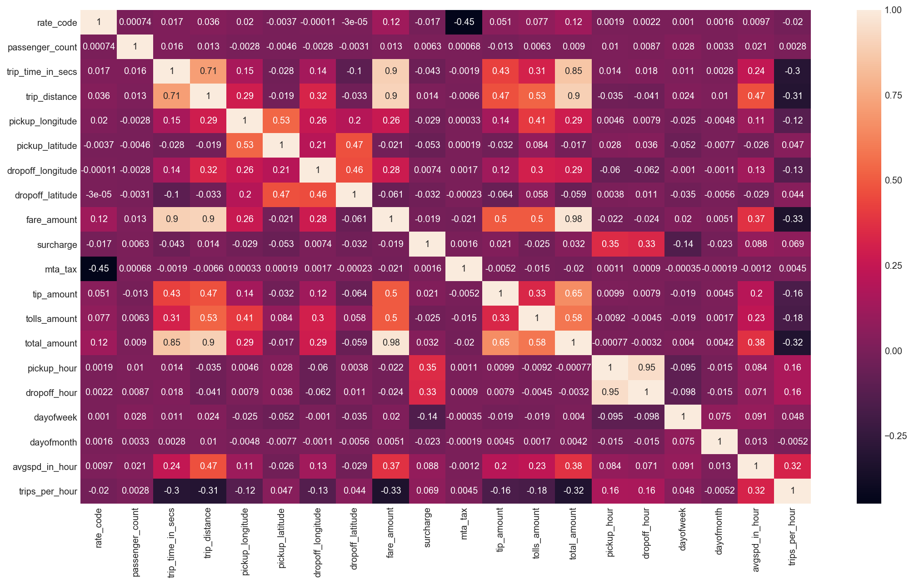
Feature Selection
Variables chosen are:
Average Speed Each Hour
Trips per Hour
Pickup geocodes
Drop off geocodes
Trip Distance
Pickup Hour
Drop off Hour
Day of Week
Day of Month

Slide 24
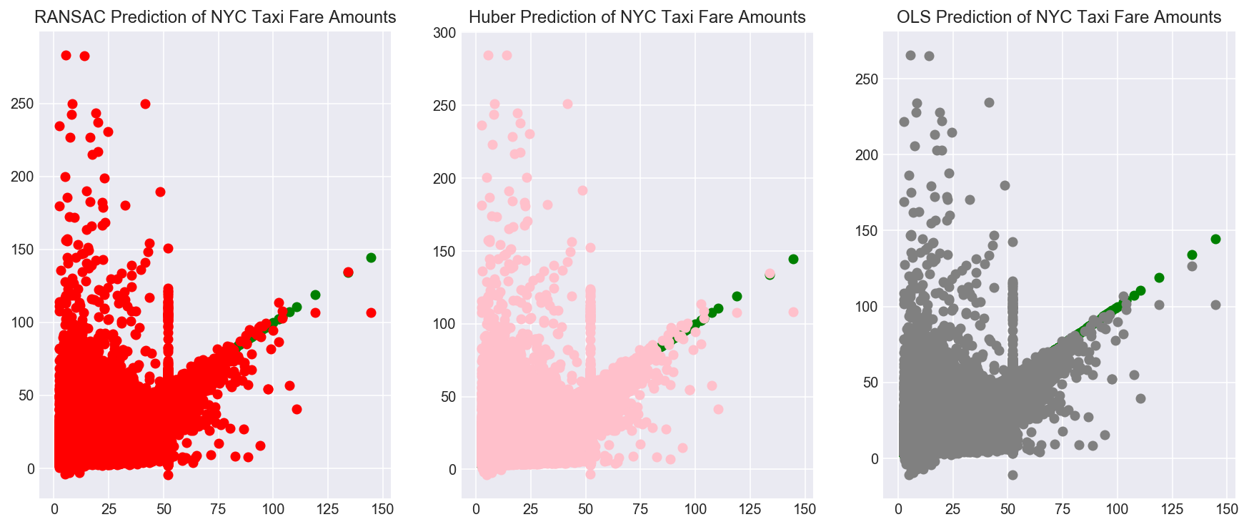
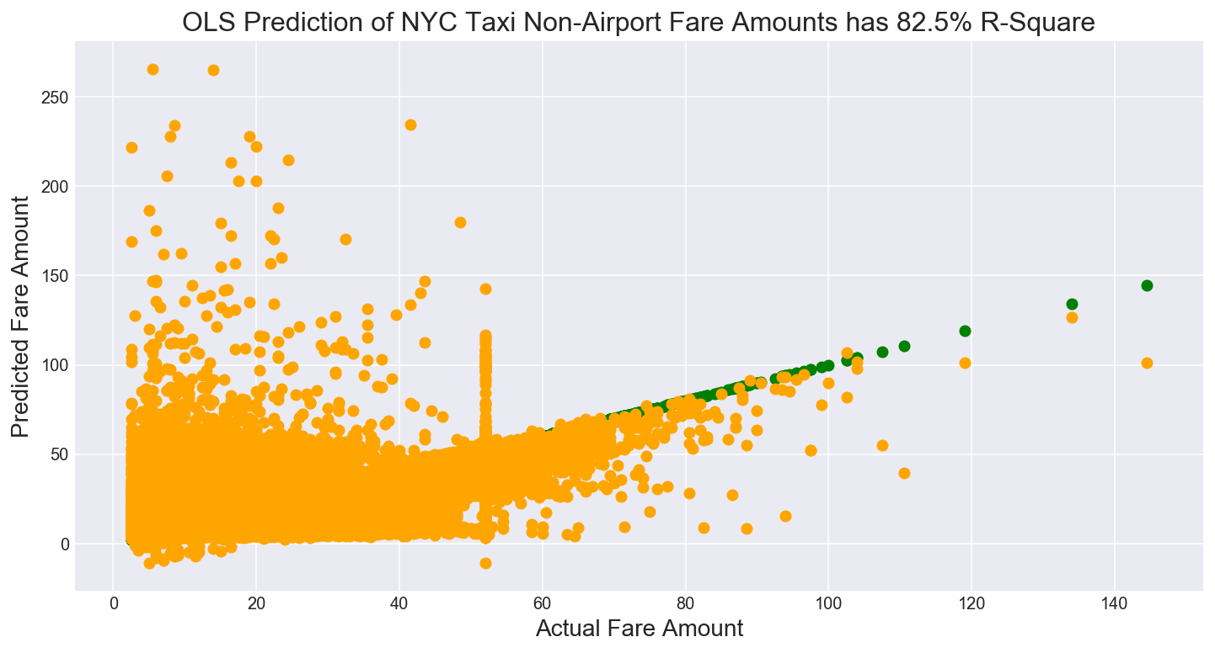
Model results for fares
OLS model gives better R-square value compared to remaining models with 5-fold cross validation and one more observation is here that the there are cluster of fares at $50 mark which requires further investigation. Either these fares were rounded or mis-reported by the taxi drivers. It may seem obvious that taxi drivers may negotiate lower fares up to $50. What is more confusing are fares where our linear model predicts a high fare, but the taxi driver only reports $50.
Are drivers pocketing these large fares?

Slide 25
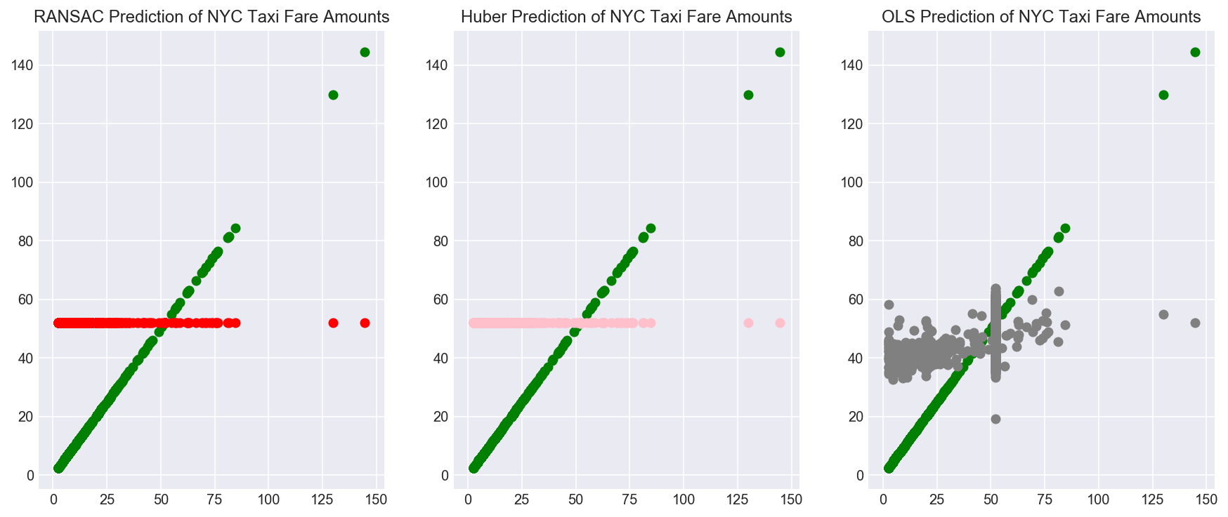
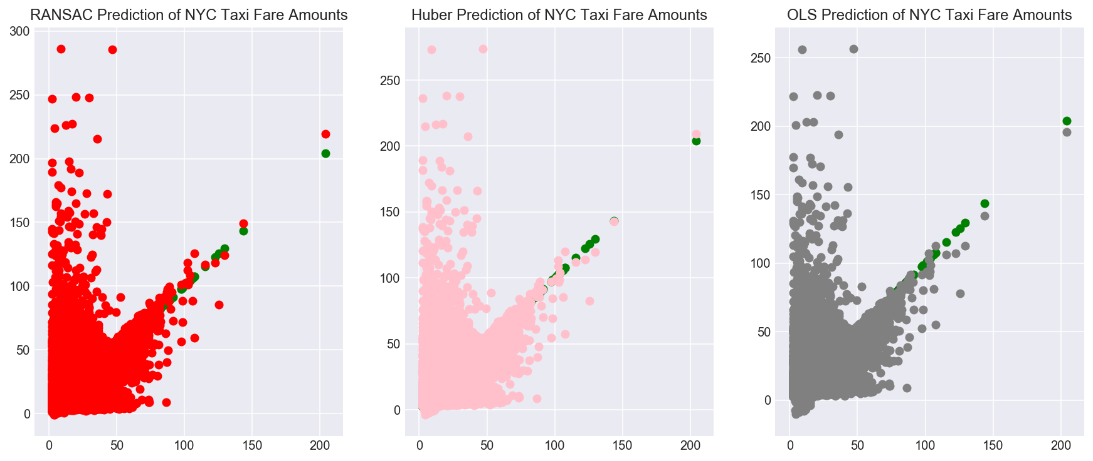
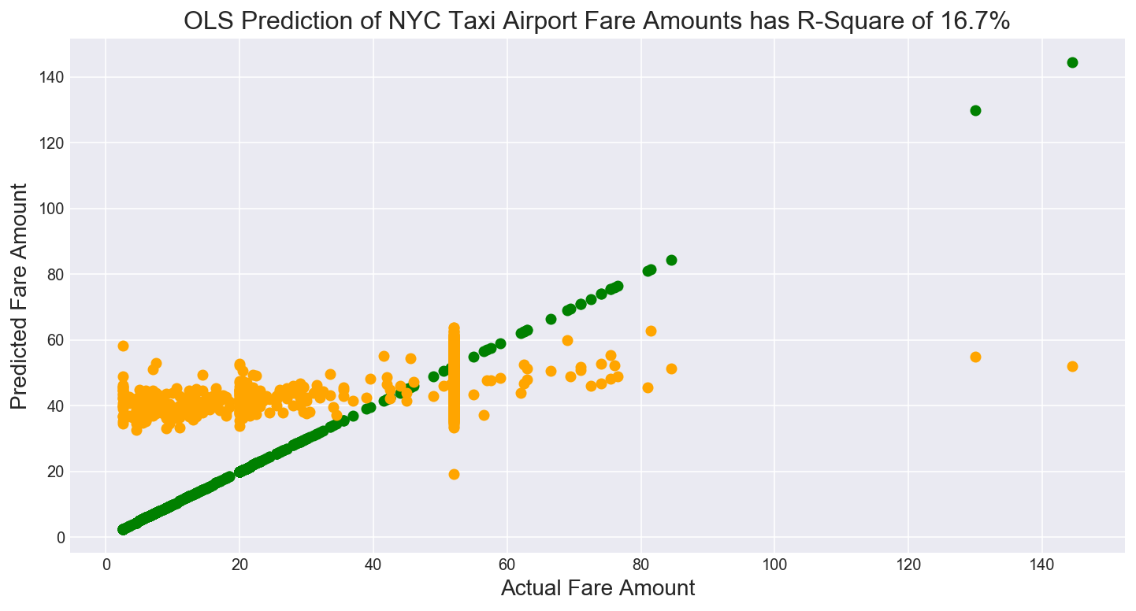
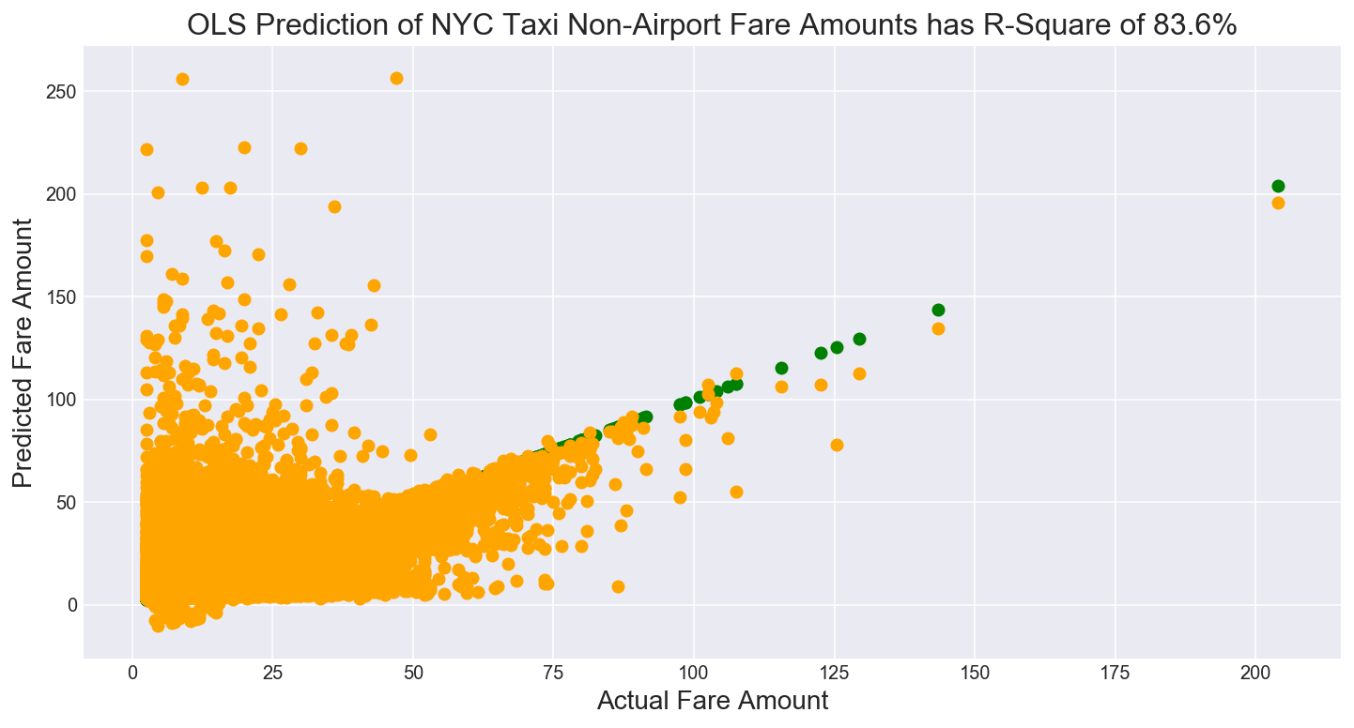
Airport results vs Non-airport results

Slide 26
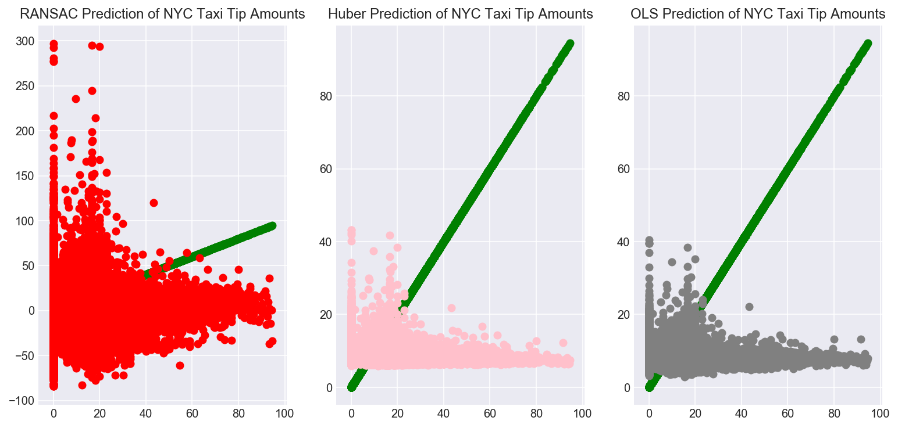
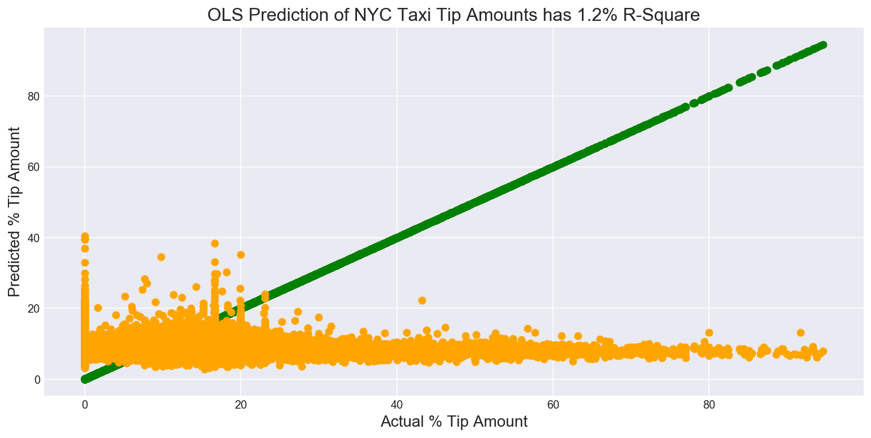
Model results for Tips
When it comes to predicting the percentage of the fare that will be left as a tip, I use a similar linear model. This time an OLS regression has an R-square of 1.2% with 5 fold cross validation when it comes to predicting how much of the fare will be a tip. The linear model does a very poor job of predicting the percentage tip amount.
We fare slightly better using a Neural Network and a Random Forest Regressor.

Slide 27
How would taxi owner maximize earnings in a day?
I distinguish between a taxi owner and a taxi driver as follows. The taxi driver is represented by the hack license and their average daily earnings in April 2013 was $259 a day. A taxi owner owns the medallion for a given taxi and can have several drivers drive their cab. The average daily earning by a medallion (taxicab) was $480 per day.
The average daily revenue for taxi drivers is $480 per day. The constraining factor here is driving hours per day. I consider two approaches: looking at routes that generate the highest daily revenue and the routes that earn the highest revenue per hour and per mile. This way a taxi owner can either concentrate on areas that generate the highest revenue or lease out a medallion taxi to two drivers driving 12 hour shifts to maximize daily revenue.

Slide 28
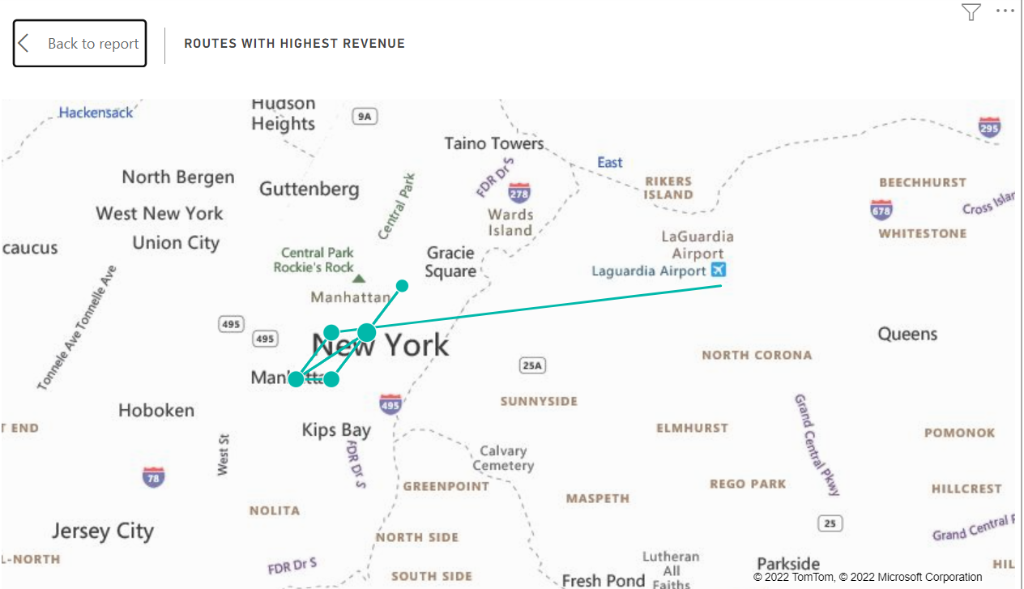
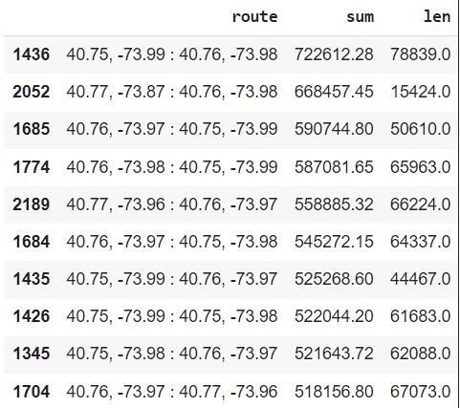
Routes with Highest revenue
These are the routes that generate highest daily revenue. Note all these trips are all based in Manhattan, except for one which is from Manhattan to La Guardia Airport.
Note from question 8, the trip to LaGuardia airport has the highest standard deviation of travel times. As total amount charged will vary will the time of the trip, consistently relying on this trip for maximizing revenue may not be the best solution. A taxi owner could prioritize taxi bookings for Manhattan trips and potentially take on other trips if they crossed the average daily revenue of taxi drivers ($480).

Slide 29
Highest revenue per hour
Another way to consider this problem is that we are trying to maximize revenue in the available time. I build a feature which is the ratio of (total_amount/time driven) in hours and see which routes maximize the earnings per hour driven. These routes can be maximized upon. Note assumptions here are that regardless of time of day these are the most profitable routes per hour.
Interestingly, these trips begin and end at the same geocode (rounded to 2 decimal places) and there appear to be intra-Manhattan geocode or intra-Airport geocode trips. These shorter trips can be used to maximize daily earnings.
The results when trying to maximize the total amount earned per mile (total_amount/trip_distance) are also same.

Slide 30
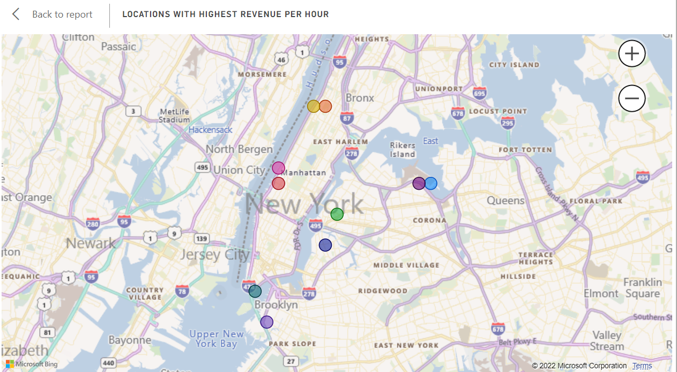
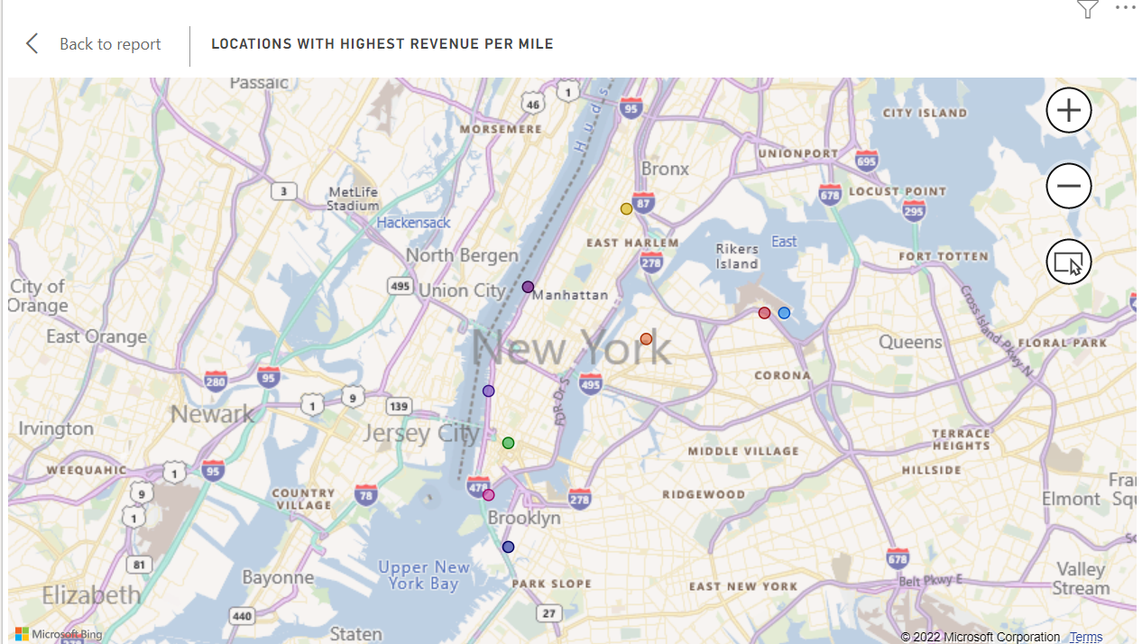
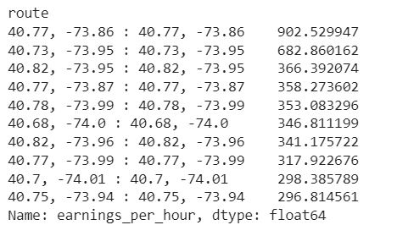
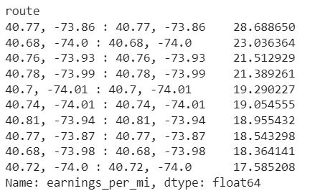
Routes with Highest revenue per hour and mile

Slide 31
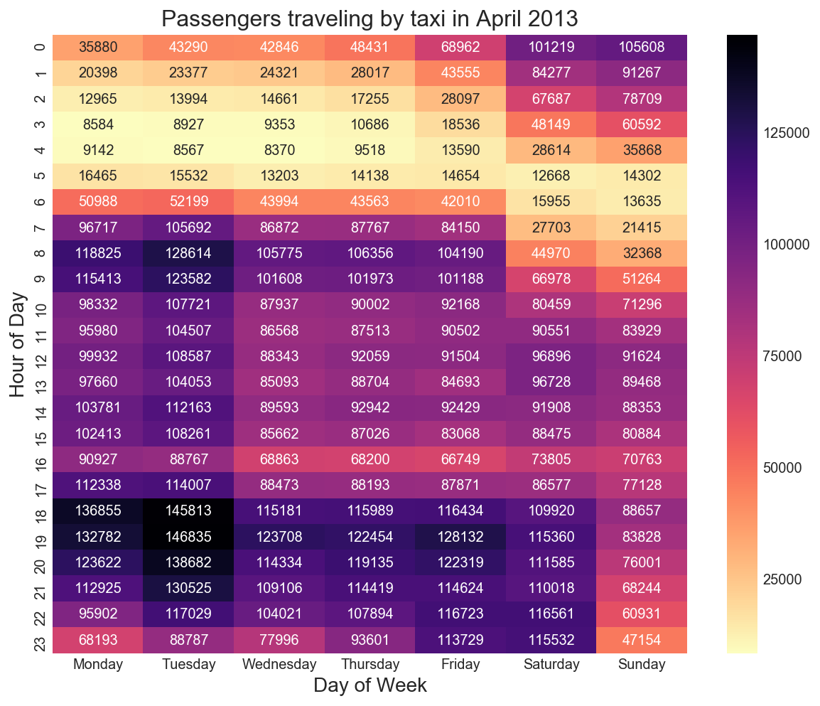
How would a taxi owner minimize work time while retaining average wages earned by a typical taxi in the dataset?
The average daily earning of a taxicab is $480 note that demand for taxicabs highest on Monday and Tuesday evenings between 6pm - 8pm or Monday and Tuesday mornings between 8 and 10 am from the passengers count heat map. This is the morning and evening office traffic.
A taxi owner looking to minimize their driver’s work time should ensure drivers are working the morning rush and evening shifts from 6pm onwards. By contrast demand for taxis is much lower between 3am - 5am Monday to Thursday, so these hours can be skipped over.

Slide 32
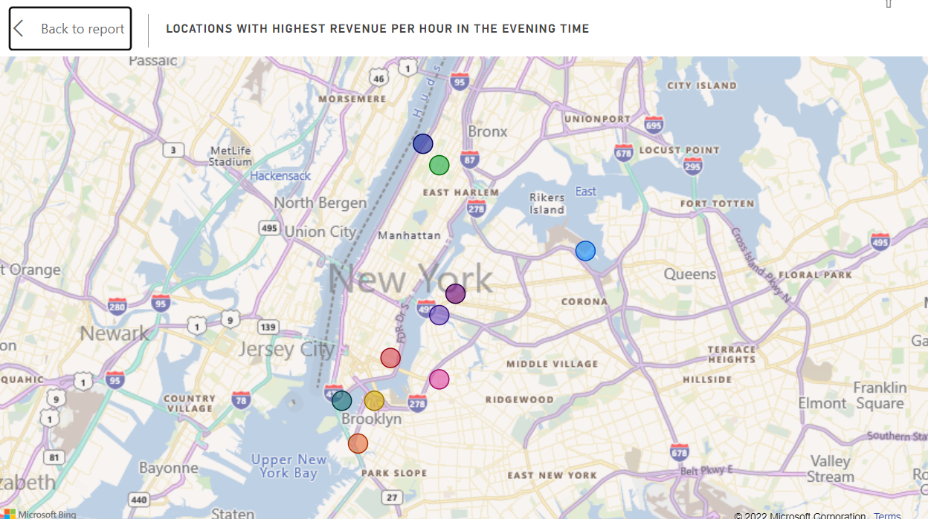
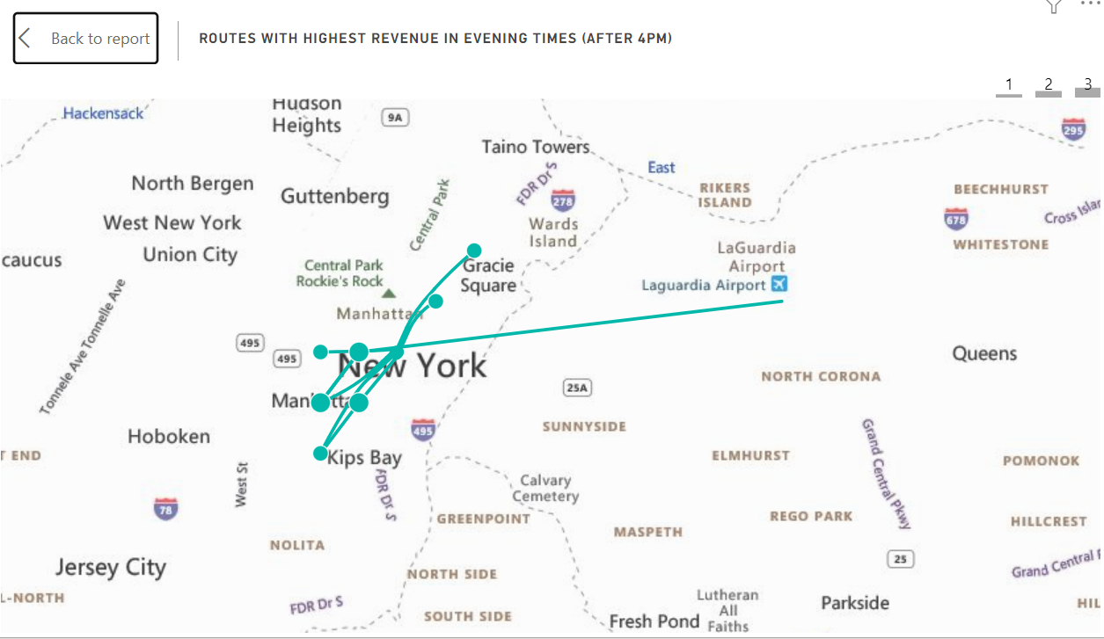
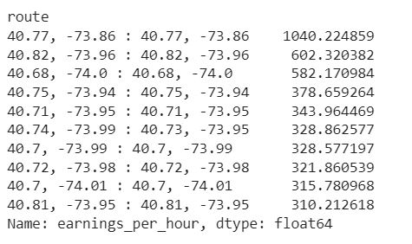
Evening results: More profits
By far the evening route that generates the most revenue per hour begins and ends from geocode (40.77, -73.86) and is an airport to airport transfer route. These are followed by several routes within Manhattan and are shown in above figures.
These evening routes generate the highest total fare amount per hour of driving. Taxis can focus on these locations until they hit their daily goal of $480 (or $259 per driver). After clearing their goal they can move on to more varied fares. Alternatively, if a taxi driver started off at a location other than the ones highlighted in figures, they can drive to these routes to make up their daily fares.

Slide 33
How would a taxi company with 10 taxis, maximize earnings?
Assume each taxi can be driven all day by 2 drivers working 12 hour shifts without wear and tear. This translates to 20 shifts per day for the taxi company. I would ensure taxis are available at the most popular pickup and drop off locations and for trips with the most consistent fares. However you wouldn’t want taxis working for the same company to undercut each other for the same fare.
My analysis so far reveals several insights for a smaller taxi company:
Instruct taxi drivers to focus on the routes with the highest earnings per hour (or earnings per mile). This would keep taxis working within smaller areas (zip codes) and would allow the company to keep a fleet of cars working airport shifts and another fleet working Manhattan island shifts. The difficulty here is whether taxis could legally deny providing service to passengers who want to travel out of these zones
Once a taxi driver has earned half the average daily wage of taxi driver ($240) during their shift, give them the option to engage out of town fares or those fares whose trip times have higher standard deviation e.g. Manhattan to LaGuardia fares or possibly out of town fares where the total amount earned may be higher.
The worst time to have a taxi out for service are weeknights or Friday and Saturday nights as these tend to be the busiest times. Get taxis serviced during the day.
The most popular routes may be overcrowded, so it may be worth focusing on trips that generate the highest total revenue with the smallest number of individual trips..

Slide 34
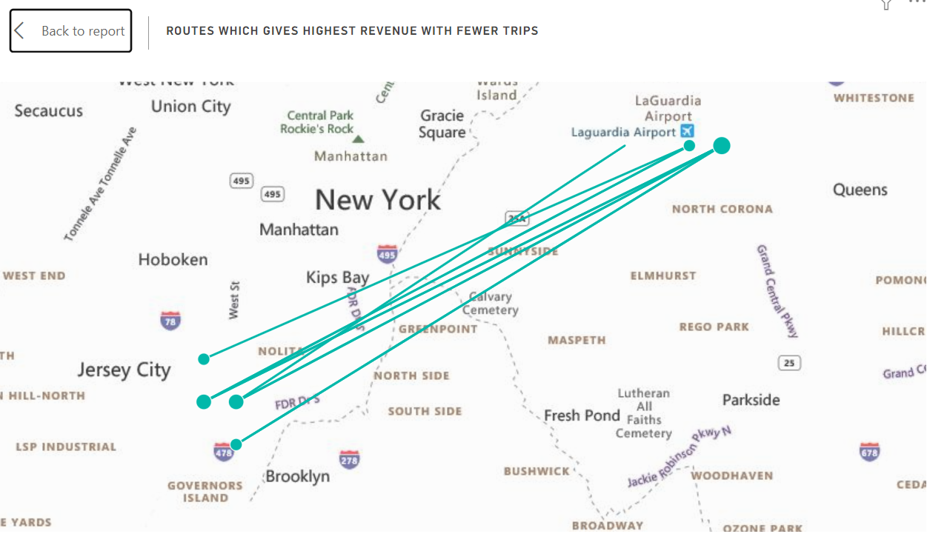
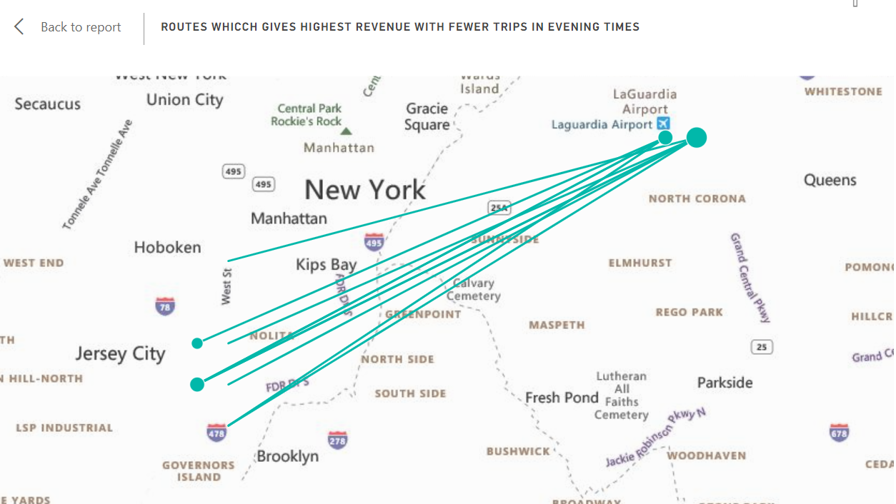
Routes which generate high revenue with fewer trips (These are the trips from LA Guardia airport)

